Slide 1

PROJECT PRESENTATION
College of Agricultural Engineering and Technology, Dr. Panjabrao Deshmukh Krishi Vidyapeeth, Akola

Slide 2
PERFORMANCE EVALUATION OF MANUAL DRAWN ENGINE OPERATED SOYBEAN HARVESTER
Under the guidance of
Dr. A. V. Gajakos
Associate Professor
DEPARTMENT OF FARM POWER AND MACHINERY

Slide 3
Presented by Sagar Rajeshrao Dudhe (RR-15) & Abhay Satishrao Wath (RR-59)

Slide 4
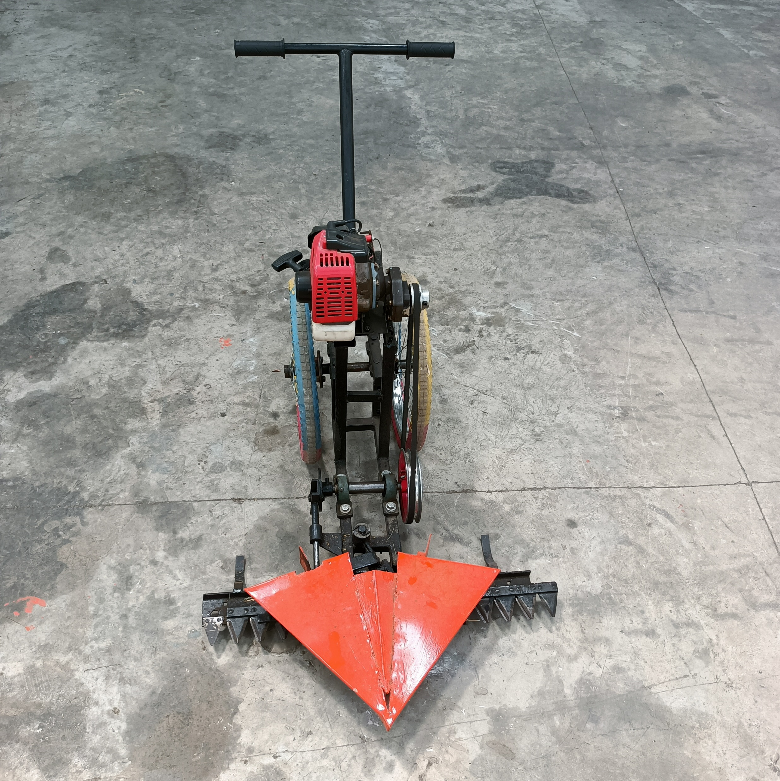
INTRODUCTION

Slide 5
Introduction
Soybean is a major oil seed crop in the India, and it is important to develop efficient and effective ways to harvest soybeans.
Manual harvesting of soybeans is labor-intensive, time-consuming, and inefficient.
This project will evaluate the performance of a manual drawn engine-operated soybean harvester.
Importance of soybean harvesting
Economic Importance
Nutritional Value
International Trade
Agricultural Sustainability

Slide 6
Soybean production in World
As you can see, Brazil is the leading producer of soybeans in the world, followed by the United States, Argentina, China, and India. These five countries account for over 80% of global soybean production.
Year | US | Brazil | Argentina | China | India
2021-2022 | 119.884 | 144 | 52 | 19 | 11.2
2020-2021 | 112.549 | 137 | 47 | 19.6 | 10.45
2019-2020 | 96.667 | 128.5 | 48.8 | 18.1 | 9.3
2018-2019 | 120.515 | 119.7 | 55.3 | 15.967 | 10.93
2017-2018 | 120.065 | 123.4 | 37.8 | 15.283 | 8.35
(In million metric tons)

Slide 7
Soybean production in India
The major soybean growing states are Madhya Pradesh, Maharashtra, Rajasthan, Karnataka, Gujarat and Telangana. Madhya Pradesh accounts for about 45% of the total soybean production in India.
State | Production (in lakh tonnes)
Madhya Pradesh | 55.84
Maharashtra | 46.01
Rajasthan | 10.62
Karnataka | 3.82
Gujarat | 2.24
Telangana | 1.51
Soybean production for the year 2022-23

Slide 8
Soybean harvesting techniques in India:
Manual-harvesting: This is the most common method of harvesting soybeans in India. It is a labor-intensive process, but it is the most affordable option for small farms.
Combine harvesting: This is a more efficient method of harvesting soybeans, but it is also more expensive
Limitations of manual harvesting methods
Labor Intensity
Time Consumption
Inconsistency in Quality
Labor Availability and Costs
Health and Safety Concerns

Slide 9
Importance and Need of Study
Labor shortage during harvesting in regions experiencing rapid industrialization and urban migration.
Intercropping soybean with pigeon pea for crop security in the dryland region of Vidarbha.
Limitations of using combine harvesters in small soybean fields and intercropping regions.
Dependence on manual labor for harvesting intercrop soybean, leading to crop losses and damage during peak seasons and untimely rainfall.
Need for a smaller, more efficient, and cost-effective soybean harvester suitable for intercropping.

Slide 10
Objective:
To evaluate field performance of manual drawn engine operated soybean harvester for soybean harvesting.
To compare the cost of operation of manual drawn engine operated soybean harvester with manual harvesting of soybean crop.

Slide 11

REVIEW OF LITERATURE

Slide 12
Patel et al., (2018) evaluated the performance of the reaper binder for Wheat crop with respect to field capacity, field efficiency, fuel consumption, harvesting losses, labour requirement and cost of operation and compared with manual harvesting method. The effective field capacity and field efficiency of the machine was found to be 0.17 ha h⁻¹ and 78.49 per cent at an average operating speed of 2.55 km h⁻¹. The cost of harvesting with reaper binder and manual harvesting was found to be Rs. 3235.11 and Rs. 5550 per hectare respectively. The losses were found to be 25.42 kg ha⁻¹. The observed fuel consumption was 1.12 L ha⁻¹ and the cost of harvesting was low as compared to manual harvesting. The feedback of machine operation was collected by some farmer’s at the time of harvesting and the performance of the reaper binder at the farm was satisfactory.

Slide 13
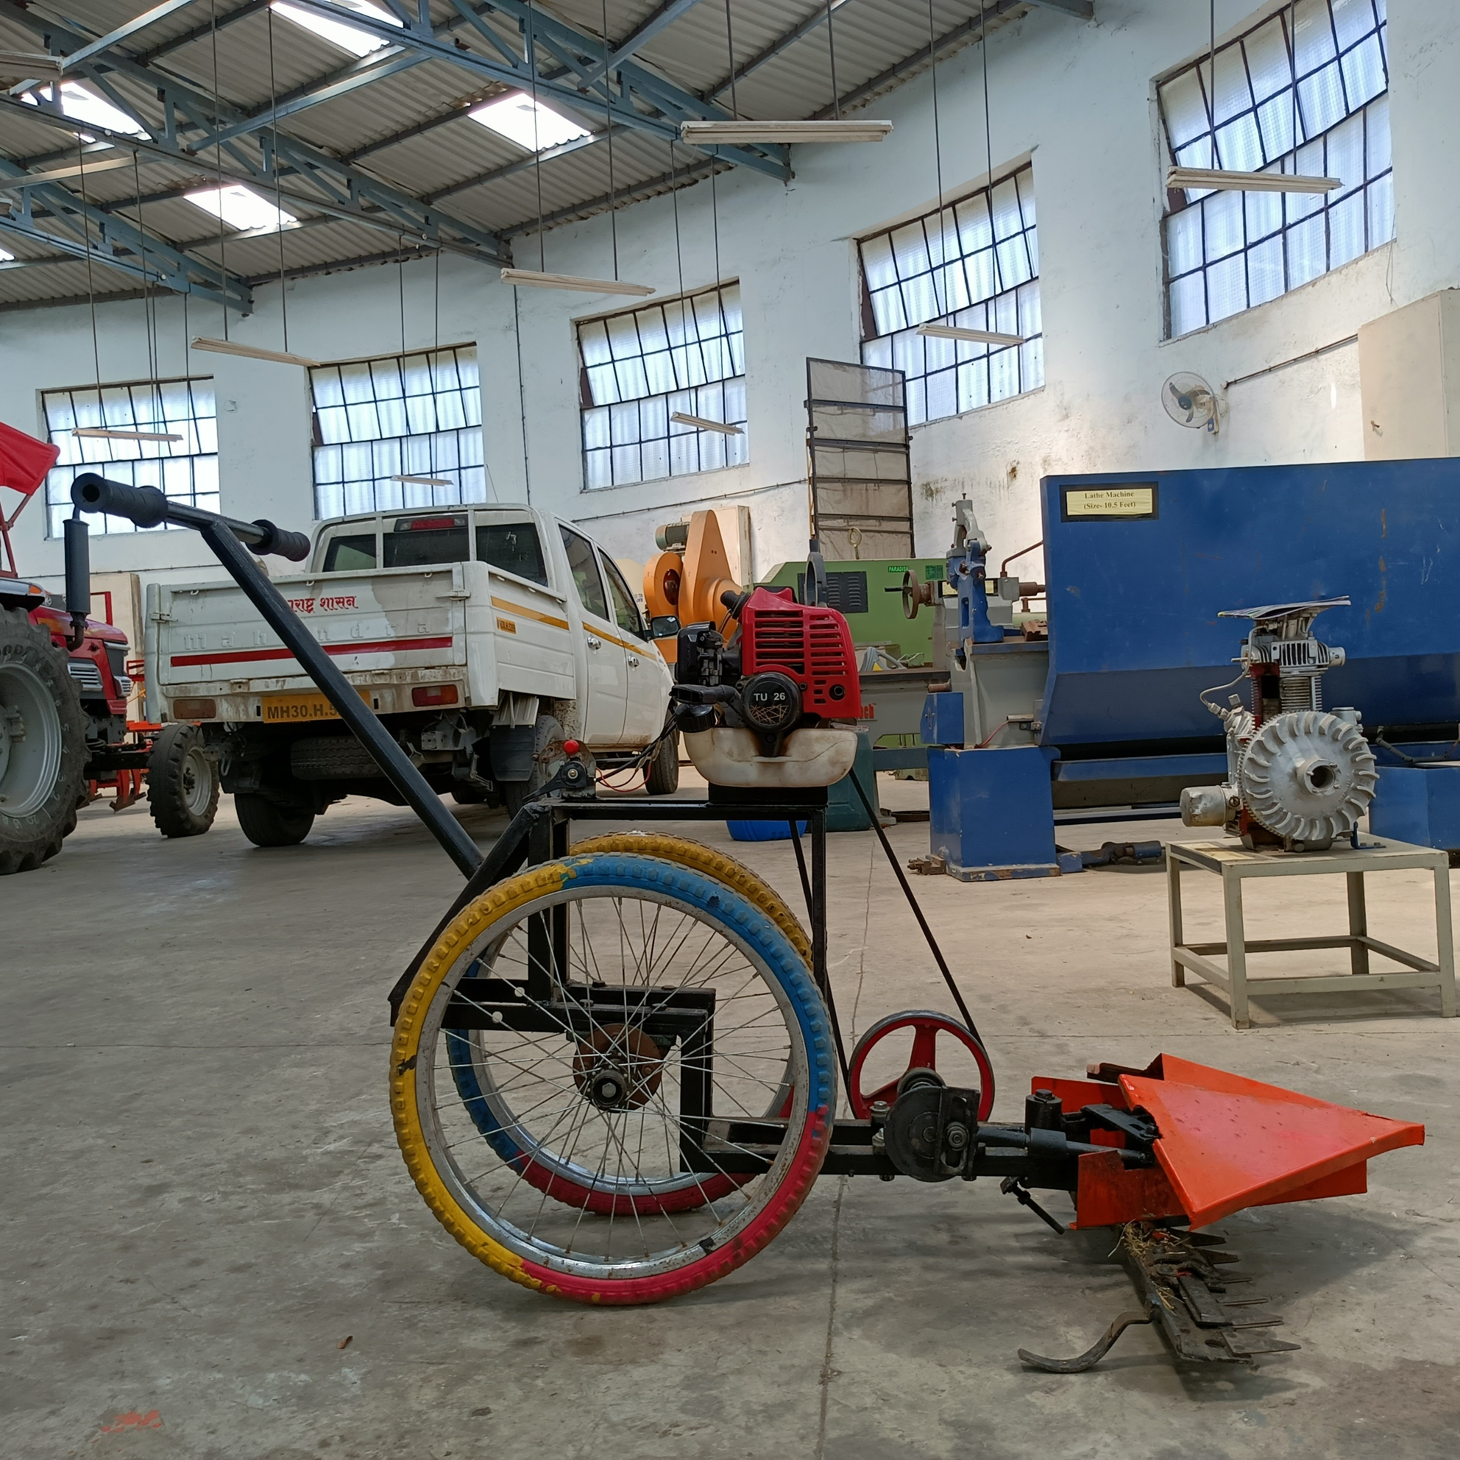
Materials and Method
Study of crop parameter
Performance evaluation
Cost estimation

Slide 14
Study of crop parameter:
Height of plant, cm
Row to row spacing, cm
Plant to plant spacing, cm
Minimum pod height from ground surface, cm
Stem diameter, cm
Plant population, per m²
Crop (grain and stem) moisture content, %
Stubble height, cm
The crop parameters are necessary to study before the performance evaluation of any machine.

Slide 15
Performance evaluation of manual drawn engine operated soybean harvester
The performance of manual drawn engine operated soybean harvester was evaluated by taking the following test
Laboratory test
Field test
Laboratory test
The manual drawn engine operated soybean harvester was parked on the firm horizontal ground surface and various dimension of machine were measured.

Slide 16
Field test
Speed of operation
Effective field capacity
Theoretical field capacity
Field efficiency
Cutting efficiency
Fuel consumption
Harvesting losses
Shattering losses
Uncut losses

Slide 17
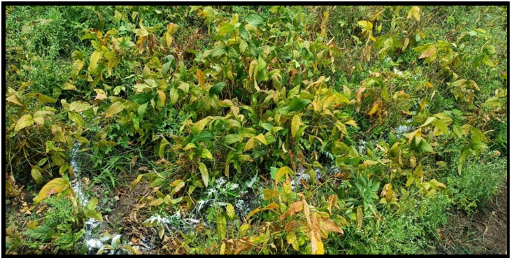
Field before testing of manual drawn engine operated soybean harvester

Slide 18
Cost of operation
The total cost of operation per hour consists of fixed & variable operating cost
Fixed cost includes
Depreciation
Interest on the capital
B. Variable operating cost includes
Fuel cost
Lubrication cost
Repair and maintenance cost
Wages of operator per hour
C. Total cost = A+B

Slide 19

Results and Discussion
Soybean crop specification
Filed Performance Result
Cost estimation

Slide 20
Soybean crop specification
Sr. No. | Parameters | Details
1 | Height of plant, cm | 56.62
2 | Row to row spacing, cm | 45
3 | Plant to plant spacing, cm | 3.6
4 | Minimum pod height from ground surface, cm | 3.6
5 | Stem diameter, cm | 0.59
6 | Plant population, per m² | 40
7 | Grain moisture content, % | 9.8
8 | Stem moisture content, % | 29.61
9 | Stubble height, cm | 9.4

Slide 21
Field Performance Result
Field trials were carried out on total area of 0.005 hectare at the field of Highway Block, Central Research Station, Dr. PDKV, Akola.
Sr. No | Parameters | Result
1 | Area covered, ha | 0.005
2 | Effective working width, cm | 90
3 | Forward speed, km/hr | 1.92
4 | Theoretical field capacity, ha/hr | 0.172
5 | Effective field capacity, ha/hr | 0.149
6 | Field efficiency, % | 86.6
7 | Fuel consumption, lit/hr | 0.460
8 | Cutting efficiency (%) | 97.83

Slide 22
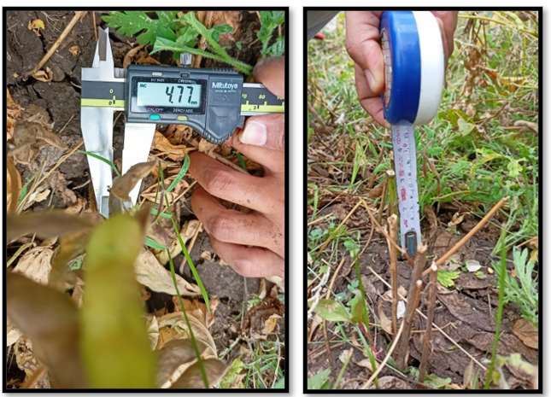
Measuring stem diameter and height of cut

Slide 23
Harvesting Losses
Sr. no | Parameters | Avg
1 | Yield from 1m², gm | 130.08
2 | Shattering losses, gm | 7.65
3 | Uncut losses, gm | 16.69
4 | Harvesting losses, g/m² | 24.34
5 | Shattering losses, % | 5.88
6 | Uncut losses, % | 12.83
7 | Harvesting losses, % | 18.71

Slide 24
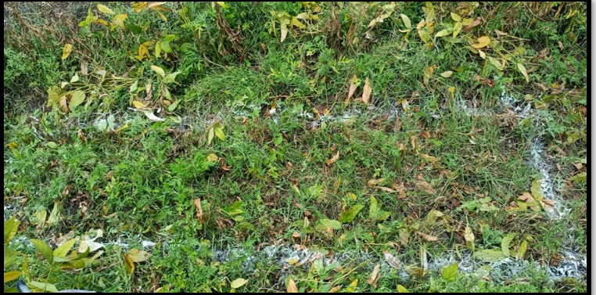
Field after testing of manual drawn engine operated soybean harvester

Slide 25
Cost Economics of manual drawn engine operated soybean harvester
The total cost of operation for harvesting soybean crop with manual drawn engine operated soybean harvester was observed that
Parameters | Manual drawn engine operated soybean harvester | Manual harvesting
Cost of operation Rs/hr | 158 | 540
Cost of operation Rs/ha | 888 | 3000

Slide 26

Summary and Conclusion

Slide 27
After conducting the field test of manual drawn engine operated soybean harvester following conclusion are drawn.
It harvests the soybean crop minimum uncut losses.
It windrowed the cut crop in the adjacent empty space between the crop row which makes it easy for collection.
In case of harvest losses, it was found that the uncut losses were more as the height of pod are more close to ground. This was due to found that plant population is more.
There is 70% saving inn cost of harvesting over manual harvesting method. However to collect the harvested soybean, manual labor is required.

Slide 28
Thank You…

